Slide 1
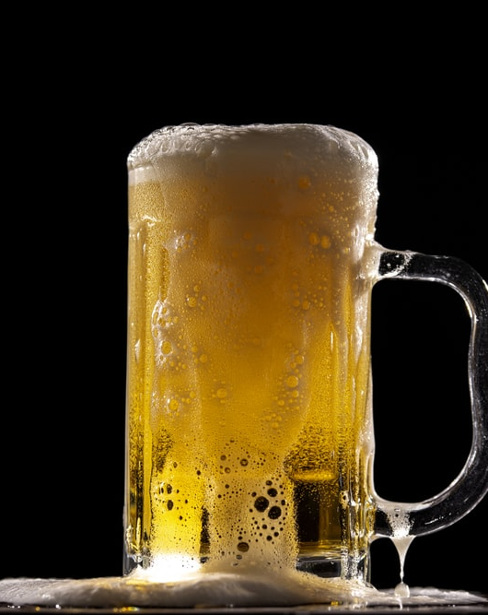
Brewery Establishment Analyst
Dawn Washington
David Owens
Grey Hardy
Notes:
To change the image on this slide, select the picture and delete it. Then click the Pictures icon in the placeholder to insert your own image.

Slide 2
AGENDA
Business Case Introduction - _________ (2 min)
Analysis - _____________(4 min)
Conclusion - _____________(2 min)

Slide 3
Business Case
Business Development: In 2017 an entrepreneur wanted to open a brewery in the United States, USA. She needed to determine the top five styles of beer that contains the highest alcohol by volume (ABV) should be produced. A competitive location was identified by finding the top five states with the least number of competitors producing those beers in that state. She analyzed 2,410 US craft beers and 510 US breweries.
Hypotheses: She assumes the beer with the highest alcohol by volume (ABV) is the most profitable.

Slide 4
Analysis Approach
Business Development: In 2017 an entrepreneur wanted to open a brewery in the United States, USA. She needed to determine the top five styles of beer that contains the highest alcohol by volume (ABV) should be produced. A competitive location was identified by finding the top five states with the least number of competitors producing those beers in that state. She analyzed 2,410 US craft beers and 510 US breweries.
Hypotheses: She assumes the beer with the highest alcohol by volume (ABV) is the most profitable.

Slide 5
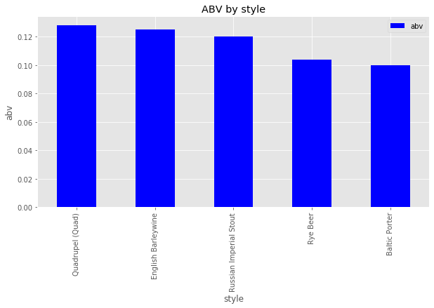
Highest ABV Among Beer Styles

Slide 6
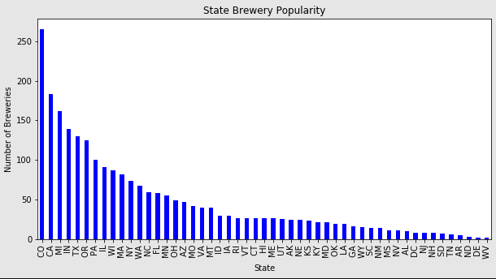
Breweries by State

Slide 7
Title and Content Layout with Chart

Slide 8
Title and Content Layout with Chart

Slide 9
Title and Content Layout with Chart

Slide 10
Title and Content Layout with Chart

Slide 11
Title and Content Layout with Chart

Slide 12
Title and Content Layout with Chart

Slide 13
Title and Content Layout with Chart

Slide 14
Two Content Layout with Table
First bullet point here
Second bullet point here
Third bullet point here
Class | Group A | Group B
Class 1 | 82 | 95
Class 2 | 76 | 88
Class 3 | 84 | 90

Slide 15
Title and Content Layout with SmartArt
Step 1 Title
Step 2 Title
Step 3 Title
Step 4 Title

Slide 16
Add a Slide Title - 1

Slide 17
Add a Slide Title - 2

Slide 18
Add a Slide Title - 3

Slide 19
Add a Slide Title - 4

Slide 21
Add a Slide Title - 5

Slide 22
Add a Slide Title - 6

Slide 23
Add a Slide Title - 7

